Slide 1
SEO Project
Comprehensive SEO audit and optimization for organic traffic growth on dineplan.net website.
A REXTON MACHADO | MBE11

Slide 2

Objective of this SEO Project
Understand website goals.
Improving the site's visibility and ranking on search engines.
Analyze current performance.
Identify strengths and opportunities for improvement.
Develop an optimization plan.
Prioritize and execute impactful SEO initiatives.

Slide 3
Company Selection
I’ve chosen Dineplan.net (https://dineplan.net) as the partner for this SEO project.
ABOUT DINEPLAN
Dineplan.net is a website about restaurant management software.
It discusses a software suite that integrates into restaurant operations to improve efficiency.
The software is designed for all F&B establishments and is affordable and user-friendly.

Slide 4
About DINEPLAN
Features of Dineplan
Point of sale system
Manage orders, payments, and customer information efficiently.
Online ordering
Allow customers to order food online for pickup or delivery.
Queue management system
Organize and streamline customer queues.

Slide 5

DinePlan's Focus
DinePlan highlights its user-friendly interface, affordable pricing, and focus on customer success, suggesting they prioritize making restaurant management software accessible and effective for businesses of all sizes.

Slide 6
Comprehensive SEO Audit
Initial Audit:
SEO audit of the Dineplan.net website to identify current performance, strengths, and weaknesses.
Keyword Research:
Identify relevant keywords and analyze competitor keywords and strategies for the website.
On-Page SEO Optimization Audit:
Check title tags, meta descriptions, and HTML tags. Improve internal linking and external structure.
Ensure proper use of keywords in content and headings.
Optimize images with alt texts and descriptive file names.
Technical SEO Audit:
Analyze the current technical SEO status and technical SEO issues on the website.

Slide 7
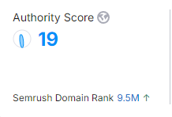
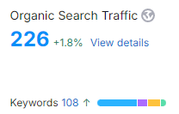
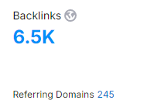
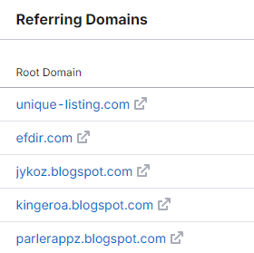
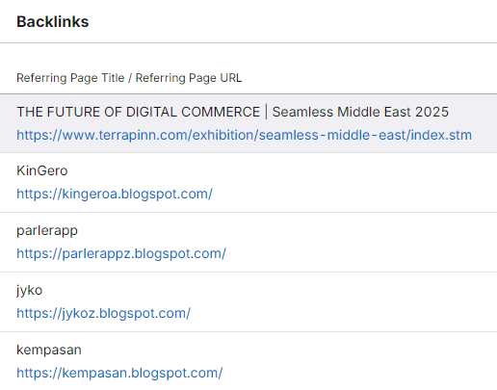
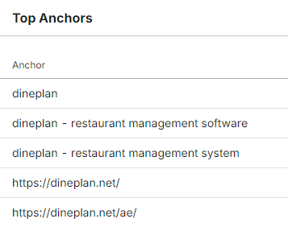
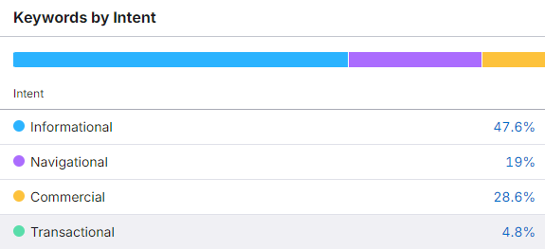
Initial Audit
● Limited information is available on the website itself regarding current SEO performance.
● Initial analysis suggests potential for improvement in keyword targeting, on-page optimization, and technical SEO.

Slide 8
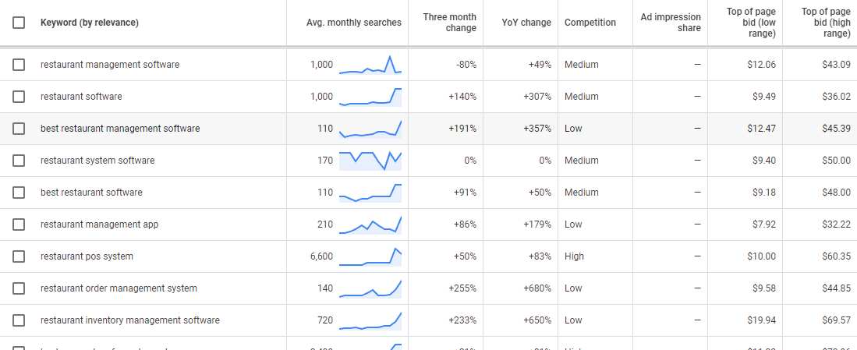
Keyword Research
relevant keywords with high search volume and low competition for the dineplan.net website.

Slide 9
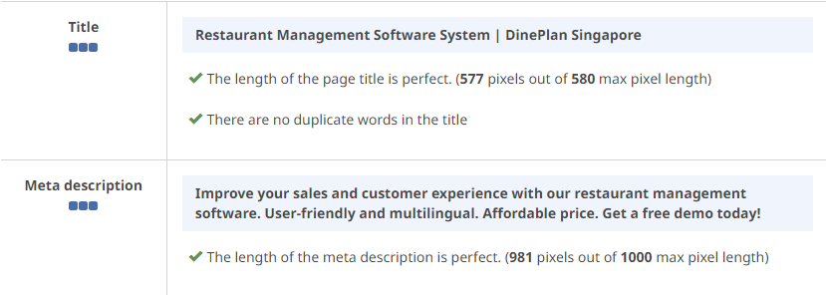
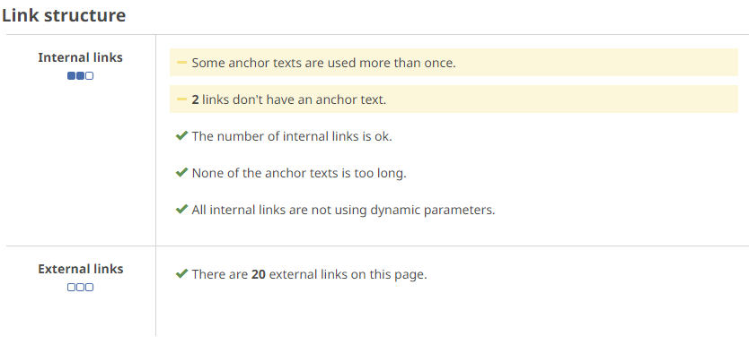
On-Page SEO Optimization
Optimize title tags and meta descriptions with relevant keywords.
Utilize targeted keywords in headings, content, and image alt text.
Implement a strategic internal linking structure.

Slide 10
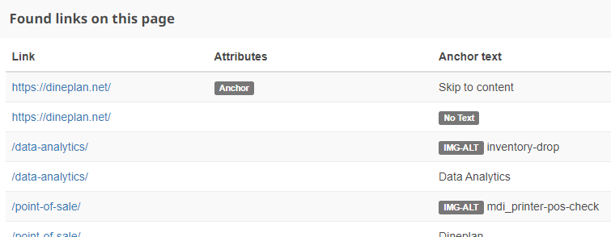
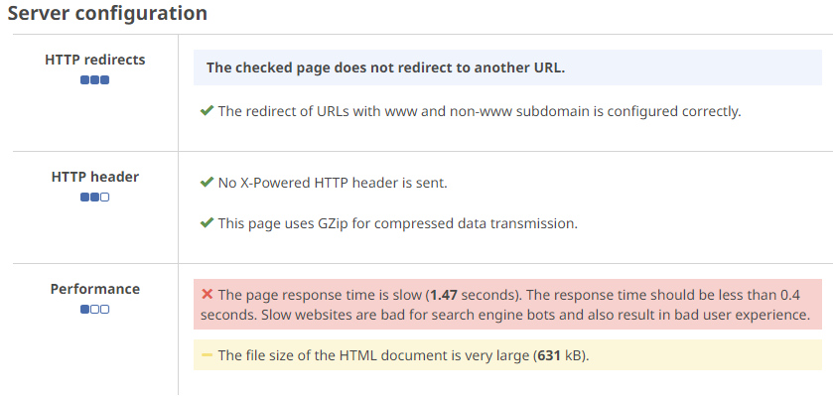
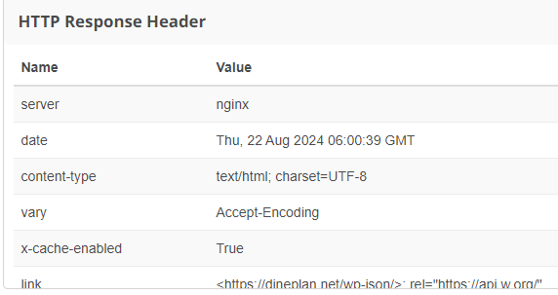
Technical SEO

Slide 11
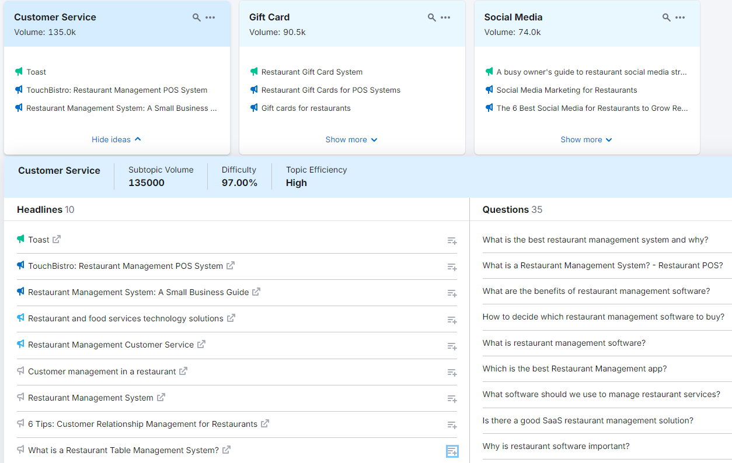
Content Strategy
Develop a content strategy plan based on keyword research.

Slide 12

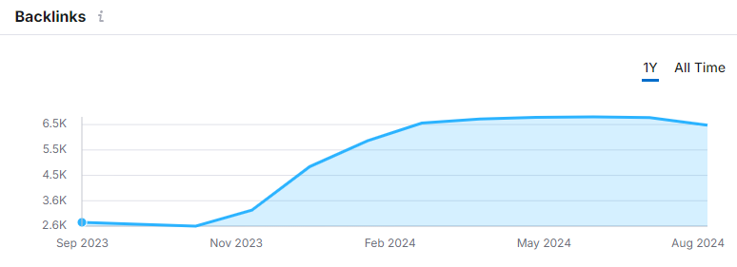
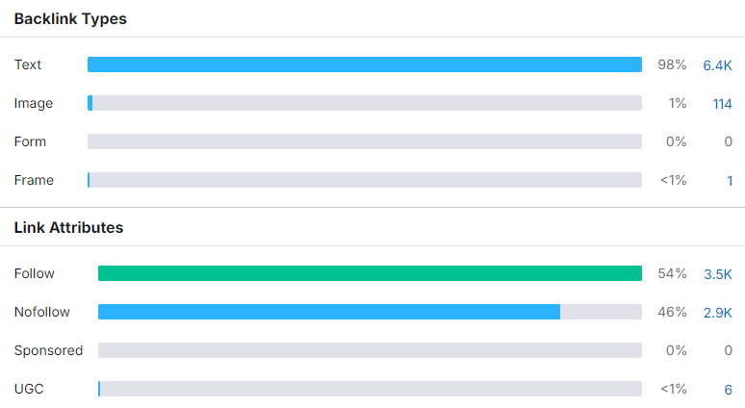
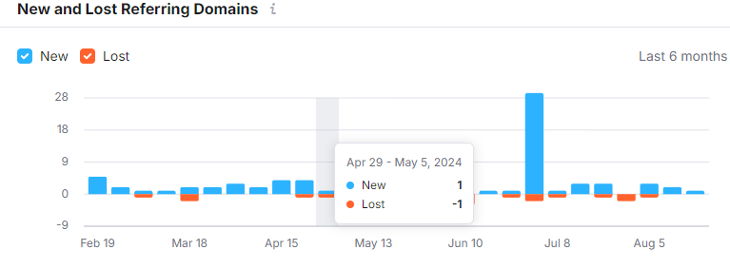
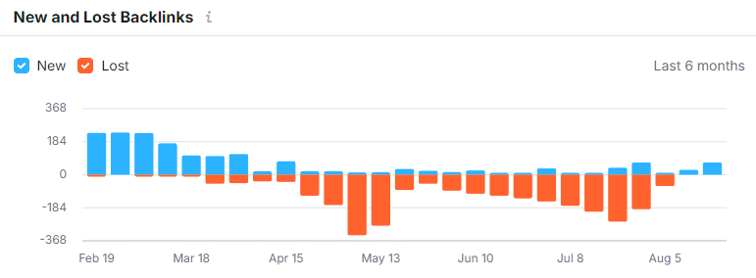
Off-Page SEO
Link Building: Build high-quality backlinks from relevant websites and industry publications.

Slide 13
Conclusion
Identified and addressed critical SEO issues.
Enhanced website's visibility and search engine ranking.
Implemented detailed audits, targeted keyword research, on-page and technical SEO improvements.
Provided strategic content and off-page SEO planning.

